Slide 1
State Directors/Representatives
MEETING
December 1-2| las Vegas, NV

Slide 2
Welcome
Tara Perry, Chief Executive Officer
National CASA Association

Slide 3
Agenda overview
Developing a CASA/GAL Network Growth Strategy
Growth Grantee Reports
  Georgia
  California
  Oregon
Discuss Growth Plan Process by Small Group
Next Steps in the Development of a Network Growth Plan
Questions and Open Discussion

Slide 4
OUTCOMES
Develop an understanding of past network growth
Learn about past planning processes
Understand from state CASA organizations in California, Georgia and Oregon:
  How their plans were developed
  Summary of their plans
  Key learnings in plan development
Contribute to formulation of the process/next steps for the development of a network wide growth plan

Slide 5
Network Growth
2005 - 2014

Slide 6
Children served
Category | 2005 | 2006 | 2007 | 2008 | 2009 | 2010 | 2011 | 2012 | 2013 | 2014
Children Served | 226,204 | 220,129 | 243,295 | 240,894 | 237,095 | 240,164 | 234,238 | 234,098 | 238,527 | 251,165
Children Served by Staff | N/A | 44,176 | 56,091 | 43,254 | 35,747 | 37,332 | 35,162 | 36,574 | 39,610 | 41,686
Children Monitored | N/A | N/A | N/A | N/A | N/A | N/A | 19,402 | 25,019 | 42,334 | 43,146
Children Served/in home | N/A | N/A | 14% | 18% | N/A | N/A | N/A | N/A | N/A | N/A

Slide 7
New children/Cases closed
Category | 2005 | 2006 | 2007 | 2008 | 2009 | 2010 | 2011 | 2012 | 2013 | 2014
New Children | 77,801 | 66,352 | 79,274 | 79,418/ 71,039 | 78,748 | 85,403 | 89,029 | 78,142 | 88,905 | 97,000
Cases Closed | 61,849 | 61,660 | 81,285 | 91,439/ 82,408 | 85,222 | 85,831 | 89,063 | 84,137 | 91,153 | 94,000

Slide 8
Volunteers
Category | 2005 | 2006 | 2007 | 2008 | 2009 | 2010 | 2011 | 2012 | 2013 | 2014
Active Volunteers | 53,847 | 57,938 | 59,717 | 68,842 | 70,919 | 75,087 | 77,021 | 77,355 | 74,918 | 76,327
Volunteers Trained | 14,806 | 15,584 | 15,836/ 18,203 | 21,134 | 23,753 | 21,507 | 21,024 | 27,921 | 21,966 | 24,186
Volunteers Left | N/A | N/A | N/A | N/A | 12,172 | 14,427 | 14,957 | 14,105 | 16,387 | 16,463

Slide 9
Total state/local programs
2005 | 2006 | 2007 | 2008 | 2009 | 2010 | 2011 | 2012 | 2013 | 2014
Membership Process
Mergers/Regional Programs
Shared Services
Underperforming programs

Slide 10
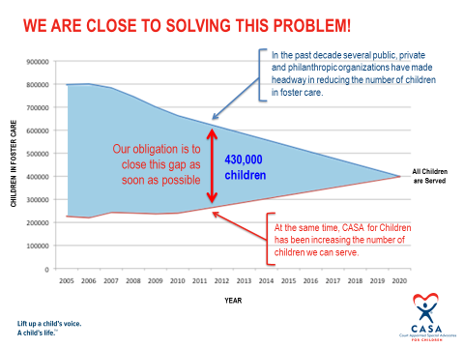
The Original 2020 Goal

Slide 11
DATA Driven strategy
Informed by:
State and local program projections
  Local program growth plans
  Statewide growth plans
  Performance data of the state and local programs
  Trends and challenges occurring in each state/nationally

Slide 12
Growth Grantee
Presentations

Slide 13
Georgia CASa Association

Slide 14
How the Growth Plan Was Developed
Build the case for serving more children
The Question – What will it take to serve more children?
  More volunteers
  More supervisory staff
  Strengthen management and resources
  Strengthen Georgia CASA support

Slide 15
How the Growth Plan Was Developed
Build the case for serving more children
2. Analyze data
Establish current baseline for children served
Identify trends
3. Determine capacity
Identify underutilization of resources
Identify target areas for immediate impact with additional resources

Slide 16
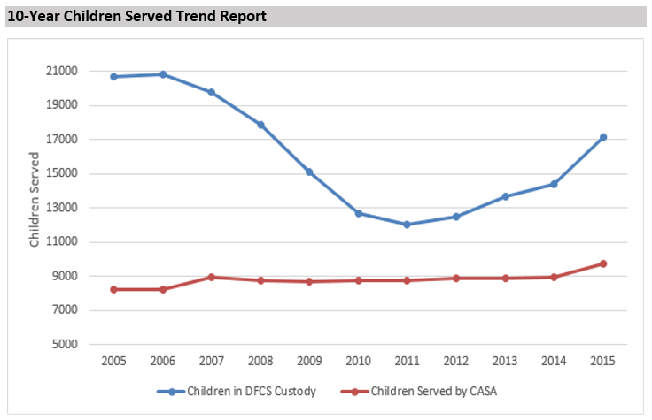

Slide 17
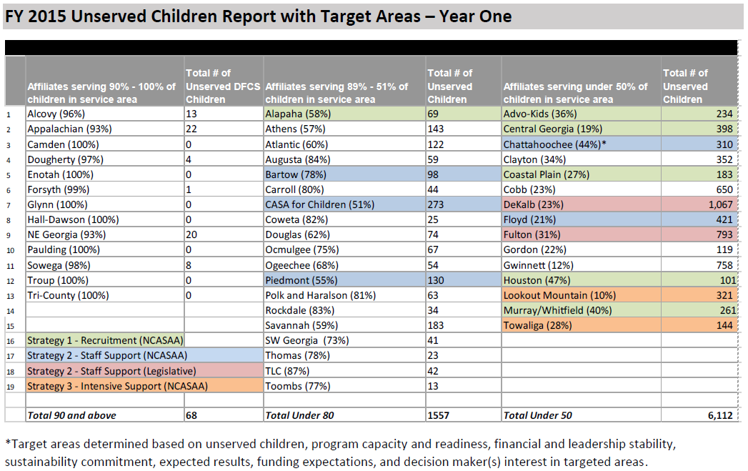

Slide 18
How the Growth Plan Was Developed
Build collaboration among Georgia CASA network
Establish network leadership team
Georgia CASA board, affiliate program leadership, state office staff, local board members, affiliate program directors in urban/high need areas
Key affiliate directors review first draft for feedback and input
Full draft shared with network for review via hard copy and webinar (live and recorded)
Surveyed network for full support of plan and interest in leadership team
Presented plan to Georgia CASA board

Slide 19
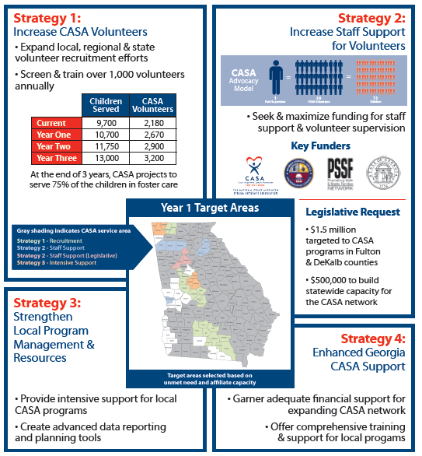

Slide 20
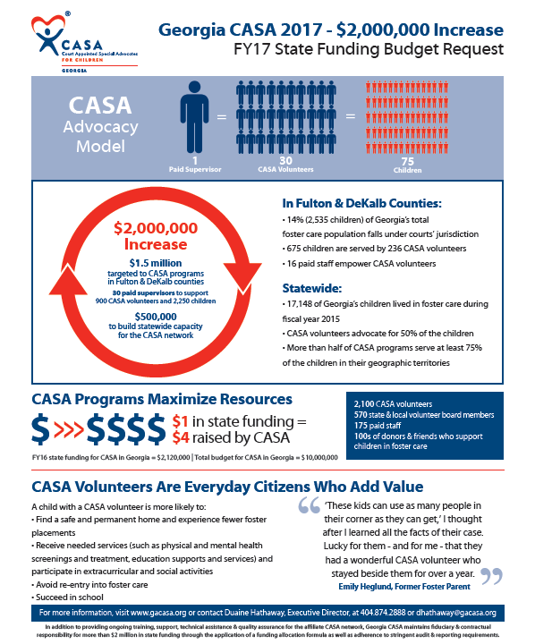

Slide 21
Key Learnings
Development of growth plan a catalyst for increased enthusiasm for shared vision and growth
Ongoing work with target areas helped to identify strengths and areas for improvement

Slide 22
Questions

Slide 23
California CASa Association

Slide 24
How the Growth Plan Was Developed
Phase 1: California CASA 5-Year Strategic Vision
2013 - CalCASA adopted a five-year strategic vision toward a CASA for every abused and neglected child who needs one in California
consultant supported the effort
network satisfaction surveys over multiple years referenced to identify trends and needs
board, staff, key funders and donors completed interviews and/or surveys

Slide 25
How the Growth Plan Was Developed
board staff retreat was held
  input from surveys was summarized/shared
  Strengths, Weaknesses, Opportunities and Threats (SWOT) were analyzed
  activities informed key priorities and strategies

Slide 26
How the Growth Plan Was Developed
Phase 2: 15,000 by 2020 Growth Plan
Preliminary discussions about the NCASA Growth Grant opportunity with staff and board
CEO Cory Pohley discussed with key staff and board
drafted an initial framework for growth
presented and discussed the framework at CalCASA’s July board meeting
Board gave permission to CEO to proceed with an application – IF initial support from the network was secured

Slide 27
How the Growth Plan Was Developed
Communications with the California network
detailed letter to the broader network
  sharing the headlines of the framework overall
  main areas for which funding would be sought from NCASA
all programs responded with initial approval and positive comments
then requested project proposals from the identified pilot project sites (based upon detailed analysis)
worked closely with them to clarify requirements and help shape project profiles
all three demonstration projects made a serious commitment

Slide 28
How the Growth Plan Was Developed
Growth Plan and grant submission
developed the full growth plan
completed the NCASA proposal
sent both documents to the proposed pilot projects for review and comment
shared both documents with the full network – and answered questions
solicited and received formal statements of approval from ALL 44 program EDs
submitted both the Growth Plan and $250,000 grant request to NCASA

Slide 29
How the Growth Plan Was Developed
Growth Plan Primary Strategies
Network has consistently requested: marketing and outreach support to grow volunteers and donors.
A timely opportunity to pursue increased state funding through policy position
Crucial to maintain core support and program quality as we grow so included resources for CalCASA’s operations and leadership of growth plan strategies.

Slide 30
How the Growth Plan Was Developed
Deciding upon demonstration projects
reviewed growth trends over multiple years
determined potential for the greatest results - counties that have:
  most unserved kids
  greatest potential to increase service
  strong leadership
  capacity to manage growth
looked for examples of broad collaboration with potential for
  replication
  growth in both diversity of volunteers and service to children
assessed the demonstration projects’ concepts and feasibility

Slide 31
How the Growth Plan Was Developed
Data used to set strategies and calculate milestones:
tracked California Judicial Council data and National CASA data over multiple years
examined progress for each county:
  a) actual numbers served and
  b) percentage of children not served in care in each county
demonstration project agencies’ growth goals determined milestones
analyzed county by county data and historical progress

Slide 32
Summary of the 15,000 by 2020 Growth Plan
Goal: Growth goal across the state: at least 6% on average every year, 2015 through 2020
Strategy:
Focus our deepest investment – including pilots and demonstration projects – in the counties with the greatest potential to move the needle on the dial
Include some targeted investments where there is a special need or priority
Then broad investment in replication and sharing of resources and best practices across all counties

Slide 33
Summary of the 15,000 by 2020 Growth Plan
Today in California: over 61,000 children and young adults in foster care
Los Angeles: 30,000
San Diego and Riverside counties combined: 10,500 children
Bay Area: 5,800
The goal will not be met evenly across all counties
some programs serve nearly all foster children
others are serving < 10% of the number of foster children
numbers range from a few hundred children in care to nearly 30,000 children
divided counties into three tiers of growth

Slide 34
Summary of the 15,000 by 2020 Growth Plan
Specific Project Activities
Enhanced marketing & communications for demonstration projects
  Voices for Children, CASA of San Diego and Riverside (See Growth Plan, Appendix B)
  CASA of Los Angeles County (Appendix C)
  Bay Area CASA Collaborative (Appendix A)
CalCASA statewide marketing initiatives
  Marketing Resource Center (MRC) on CalCASA website
  30 second CASA TV ad with tailored landing pages for each local program

Slide 35
Summary of the 15,000 by 2020 Growth Plan
Specific Project Activities
Policy Coordinator position to build momentum to increase CASA network state funding.
Perfectly positioned to grow our policy efforts as the state had a budget surplus
Governor has called for a reorganization of funding for Victims of Crime, to occur prior to July 2016.
    organize local CASA programs and tap into their wealth of expertise and political connections
    leverage this effort to increase funding for CASA by administrative and legislative advocacy

Slide 36
Summary of the 15,000 by 2020 Growth Plan
Measuring Progress
Measurement against growth plan goals
Statewide growth in children served by at least 6% at the end of each calendar year (2016)
Increase in the overall diversity of CASA volunteers statewide
Total children served, new children served, new CASA volunteers and total CASA volunteers will be assessed annually through:
  Judicial Council child and volunteer data
  NCASA child and volunteer data

Slide 37
Summary of the 15,000 by 2020 Growth Plan
Measuring Progress
Demonstration projects have also each identified their own objectives, goals and measures – see Appendix A, B and C
  tracking against the number of volunteer and training inquiries received following a specific campaign
  assessing public interest by tracking click-through rates in social media
  overall web traffic
  inquiring how a potential volunteer learned about the CASA opportunity through application form questions

Slide 38
Learnings From Growth Plan Process Thus Far
Importance of engaging key stakeholders at every stage
  board advice and buy-in early
  shared the high-level framework with the full network
  incorporated comments and input
  fairly sure of full endorsement from the network once the plan and proposal were shared in final form

Slide 39
Learnings From Growth Plan Process Thus Far
Importance of use of data and transparency in the decisions
  base decisions on data and clear criteria
  show the reasoning and logic behind the selection of pilot projects
Already seeing the value of a clear and ambitious growth goal
  a blueprint for how to get there
  we have shared it with our funders and received high interest: example: Walter S Johnson Foundation is inspired to considered pass through funds in line with the plan

Slide 40
Resources
Resources on the California CASA website:
CalCASA 15,000 by 2020 Growth Plan
California CASA 5-Year Strategic Vision PPT
http://www.californiacasa.org/who-we-are/financial-annual-reports/

Slide 41
Questions

Slide 42
Oregon CASA Network

Slide 43
How the Growth PLAN Was Developed
Prior history
Statewide key definitions
Network consensus
Urban Action Plans

Slide 45
Data Definitions
Total Children Served The number of children with an active CASA volunteer assigned to them with an open dependency petition within a CASA program’s jurisdiction. This does not include children whose jurisdiction is with another program.
Point in time: For a particular day, the total number of children who had an open dependency petition, regardless of type of placement (i.e. foster care vs. in home placement), and had an assigned CASA volunteer.

Slide 46
Data Definitions
Period of time: For a particular date range, the total number of children who had an open dependency petition, regardless of type of placement, and had an assigned CASA volunteer at some point during that time period.
Total Children in Care as reported by DHS The total number of children in the DHS one day in care report for a given county/ies, unless the program has a written exception from the OCN.

Slide 47
Data Definitions
Total Children Unserved Point in time: On a particular day, the number of Total Children in Care (see above) who did not have an assigned CASA volunteer on that day (calculated by subtracting the number of Total Children Served from the Total Children in Care as Reported by DHS at the same point in time).
Period of time: For a particular period of time, the Total Children in Care (see above) who did not have an assigned CASA volunteer during that entire period of time (calculated by subtracting the number of Total Children Served from the Total Children in Care as Reported by DHS over the same period in time).

Slide 48
Data Definitions
Volunteer Status
Active: Volunteers who are currently assigned to a child/ren in dependency, including cases that are a courtesy to another program.
Inactive: Volunteers who are not currently assigned to an active case. Can be inactive for up to 12 months without being required to retake pre-service training.
Peer Coordinator: Volunteers who support active volunteers.
Retired: Volunteers who have formally resigned verbally or in writing, or have been inactive for more than 12 months. Includes volunteers who have moved from the area.
Terminated: Volunteers who were dismissed from the CASA program by program staff.

Slide 49
Data Definitions
Total # of Volunteers
Point in time: For a particular day, the total number of active CASA volunteers assigned to an open dependency case.
Period of time: For a particular period of time, all CASA volunteers assigned to an open dependency case at any time during that date range.

Slide 50
Data Definitions
Volunteer Retention Rate The percent of active CASA volunteers that remained active during a specific date range. This number is calculated by taking the number of active volunteers at the beginning of a time period, adding in any who became active during that time period and determining what percent of those same volunteers were still active at the end of the time period.

Slide 51
Data Definitions
Monitor The case is being observed: staff has no in-person contact and recommendations are not made to the court.
Close Date The date that CASA received a dismissal order or case closing order from the court.

Slide 52
Summary of Growth Plan
Focus on urban programs
Leverage strengths of local and state roles
Local program highlights

Slide 53
Key Learnings
Collaboration and group process
Role of local programs
Role of state office

Slide 54
Questions

Slide 55
Developing the process

Slide 56
Goal
Network wide SUSTAINABLE growth plan
Data supported and driven
Unified message/shared vision
Roadmap for the future of the CASA/GAL network
  Funding requests: $$ to go to scale
  Developing resources
  Metrics to measure

Slide 57
Local program projections
Local Program
Local Program
Local Program
Statewide Growth Plan

Slide 58
State program projections
State A
State B
State C
CASA/GAL Network Wide Growth Plan

Slide 59
Small group discussions
• What questions need to be answered before we can develop a network wide plan and strategy?
• Where are you in development of a statewide growth strategy and plan?
• What has helped in development of your plan?
• What process would you recommend for establishing a network wide growth strategy and plan?
• What resources do you need to develop/complete development of your state’s plan?

Slide 60
Next Steps in Development
Of A Growth Plan

Slide 61
Questions and Open Discussion

