Slide 1

National CASA Association and
State Directors Meeting
April 6, 2015

Slide 2
Welcome
Tara Perry, Deputy CEO & Chief Operating Officer

Slide 3
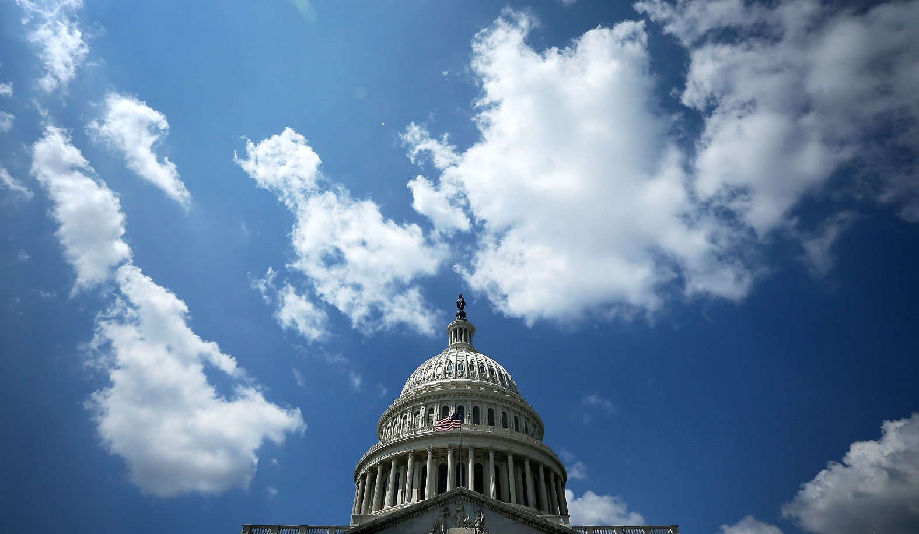
Federal Funding & Policy Update
Cynthia Smith, Chief Legal & Advocacy Officer
Ashley Lantz, Public Policy Director

Slide 4
Federal Funding Update
$12 Million Full Funding of CASA Program for FY 2016
  Programmatic requests – nationwide collaboration
  Dear Colleague letters to CJS Appropriations Subcommittee
    58 House members on Bass Dear Colleague letter
    16 Senate members on Peters/Ayotte Dear Colleague letter
  Testimony to House and Senate CJS Subcommittees
  Next – Markup Hearing preparation
Notes:
Dear Colleague letters and Testimony are on the National CASA website on the Public Policy Page (News and Events)

Slide 5
Hill Outreach
New “Luminate” Action Alert system
      One-click constituent messages to elected officials
      in the House and Senate
      Easy customization of a standard message
      Social Media sharing
      Capable of monitoring response
      Captures supporter information
3,663 email messages from CASA members partners and supporters were sent to Hill offices in Dear Colleague campaign
Notes:
State leaders helped encourage local programs to participate
Link to Action Alert urging Congressional support for funding generally is still available, from Public Policy page

Slide 6
QUESTIONS

Slide 7
Working with
State Organizations
Melissa O’Neill, State Steering Committee Co-Chair
John Wyble, Director of State Development

Slide 8
State Steering Committee Update
Update from March 2015 call
Categories of States
Resource States
Identifying Highly Effective States

Slide 9
Categories of states
Developmental
Strategic
Highly Effective
Innovative program or practice
Continued discussion to identify criteria
Growth potential
State office capacity
Readiness to impact local programs
Advocacy
No infrastructure or staff
Limited or no capacity
Beginning development or redevelopment

Slide 10

Resource States
Competence in 1 or more key areas
Partnership with National CASA
Areas may include: Technical Assistance, Resource Development, Quality Assurance, Branding & Marketing, Governance

Slide 11
Highly Effective States
Innovative Practice(s)
Demonstrated, measurable outcomes that exceed average network performance
Consider other criteria to identify Highly Effective states
State Steering Committee to facilitate discussion at Conference

Slide 12
Grants Policy Discussion - Categories
Growth | At least one grant in each category: States at <30% of children served States at 45-55% of the children served States at >80% of the children served
Development | Select up to 5 proposals: States without a formal state organization States with a state organization with limited capacity
Resource | Select 5-8 proposals No direct monetary support but would receive targeted and enhanced resources and expertise to support a statewide project in a key strategic area
Local CASA/GAL Grants | Competitive, internal review based upon set criteria with input from state offices with overarching goal to build capacity
Strategic Investments | Strengthening National CASA Infrastructure to Better Serve the Network, 2015-2016 priorities that would impact all state and local CASA/GAL organizations: Performance Measurement Project Professional Development National Fundraising Activities: Big Give Building expertise at National CASA to support network

Slide 13
Grants Policy Discussion - Growth
Growth | Based on Needs Assessments of each state Gather data and confirm percentages of children served by state Determine which states should be included in each of the targeted growth ranges
Goal | Demonstration projects would be evaluated as to success and impact to inform grant allocation for next year as well as provide data and analysis for acquiring additional funding based on success of demonstration year.
Targets | At least one grant in each category: States at <30% of children served States at 45-55% of the children served States at >80% of the children served
Strategies | Second year: Dependent on progress, availability of funding and strategic focus areas. Competitive, internal review process based upon set criteria

Slide 14
Grants Policy Discussion - Development
Development | Select up to 5 proposals: States without a formal state organization States with a state organization with limited capacity
Goal | Demonstration projects would be evaluated as to success and impact to inform grant allocation for next year as well as provide data and analysis for acquiring additional funding based on success of demonstration year.
Strategies | Second year: Dependent on progress, availability of funding and strategic focus areas. Competitive, internal review process based upon set criteria

Slide 15
Grants Policy Discussion - Resource
Resource Grants | Select 5-8 proposals No direct monetary support but would receive targeted and enhanced resources and expertise to support a statewide project in a key strategic area
End of Grant Goal | Demonstration projects would be evaluated as to success and impact to inform grant allocation for next year as well as provide data and analysis for acquiring additional funding based on success of demonstration year.
Statewide Focus | Marketing & Branding Resource Development Planning State Advocacy Outcome Measurement/Evaluation | Capacity Building and Planning Volunteer Recruitment/Retention Human Resources Financial Management
Example Projects | Website Development I AM FOR THE CHILD campaign State Advocacy: Targeted Partnership | Board Governance (State org or support to local programs) Peer Coordinator Model (Volunteer Recruitment/Retention)
Strategies | Resource grants would be one year in duration. Competitive, internal review process based upon set criteria

Slide 16
Grants Policy Discussion – Local
Local CASA/GAL Grants | Capacity Building for Local Programs
Goal | Additional children will be served
Strategies | Local CASA/GAL grants are one year in duration Competitive, internal review based upon set criteria with input from state offices

Slide 17
Grants Policy Discussion -
Strategic Investments
Strategic Investment | 2015-2016 priorities that would impact all state and local CASA/GAL organizations: Performance Measurement Project Professional Development National Fundraising Activities: Big Give Building expertise at National CASA to support network
Goal | Strengthen National CASA’s Infrastructure to better serve and support the Network
Assessment | Identified, set performance indicators for National CASA and network satisfaction with National CASA’s services and resources

Slide 18
State Needs Assessment Timeline
Finalize Interview Process
February
Schedule/ Complete Meetings
March
Construct Dashboards
April
Present Work Plans
July
Develop Work Plans
May/June
Survey Local Programs
May

Slide 19
QUESTIONS

Slide 20
Program Services
Sally Erny, Chief Program Officer

Slide 21
New Model of Service Delivery
Beginning April 1:
State organizations continue to provide high quality support to local programs
National CASA functional units
National CASA Member Services Unit

Slide 22
Functional Units
Finance & Administration
Capacity Building & Planning
Legal & Advocacy
Program Services including Member Services
Training & Organizational Development
Marketing & Brand Management
Resource Development

Slide 23
Member Services
CASA
Network
Membership
Quality Assurance
Technical Assistance
Inquiries
Membership Resources
Reporting
Satisfaction Surveys
Membership Information Management
List Serve Management
Grants
Compliance
Member Communications
Member Services
will support state
organizations and
local programs

Slide 24
Member Services
To Contact:
  855-691-6317
  MemberServices@CASAforChildren.org
Your Call or Email
  Will be answered promptly
  By a member of our team who has program knowledge & expertise
Assessment
  90 days to pilot and assess the unit
  Determine need, volume and areas for improvement

Slide 25
Menu of Services and Departmental Directory
Guide to who to call at National CASA for specific questions and resources
  Sent to all members April 1
  Posted on the State & Local landing page of CASAforChildren.org
If in doubt about who to contact:
  Call or email Member Services

Slide 26
Support to State Organizations
Sally Erny, Chief Program Officer
  Day-to-day support of state organizations
  Grants, Membership, Quality Assurance
John Wyble, Director of State Development
  Special initiatives related to developing and strengthening state organizations
  State Steering Committee

Slide 27

National CASA Conference Update
May 30-June 2 at the New Orleans Sheraton
Overflow hotel – Hilton Garden Inn
Conference registration
Dynamic keynote speakers
  Tavis Smiley
  Tim Elmore
Awards of Excellence winners announced to network this week

Slide 28
National CASA Conference
May 30 State Directors and Representatives Meeting
  Planning group of state directors working on the agenda
  Suggestions for meeting topics to johnw@casaforchildren.org
State Director Track
  Three sessions on Sunday, May 31
  Three sessions on Monday, June 1
  Session topics being finalized – send suggestions to johnw@casaforchildren.org
Celebratory send off for Michael Piraino
  Board recognition at May 31 State of CASA Luncheon
  Reception on June 1 from 6-7 p.m.
  Video
  More details forthcoming

Slide 29
Quality Assurance
Wave 3
  Due March 1
  211 programs in the wave
  Compliance support provided by state organizations and National CASA
Development of a New QA System
  Redesigning our QA system to be more robust, efficient and meaningful
  Working with states in the redesign
  Will address existing systems and variables in individual states
  Waves 4 and 5 will be delayed
  All programs in these waves and their state organizations will be notified
  Will be the first programs to go through a new system of QA

Slide 30

Annual Survey
Local Program Survey
  Opened February 3
  Deadline for submission was March 6
  State organizations have access to all local program survey information
  Submission rate – 90-93% on key indicators
State Organization Survey
  Will open in April
  Will contain both:
    Questions regarding your state organization
    Questions regarding your satisfaction with National CASA services and resources

Slide 31
Enhancements to Communication
Beginning in April
  CASA-GAL Update
    Monthly Update to State Directors and Representatives
    Monthly Update to Local Program Directors
    Monthly Update to other stakeholders
  Breakthrough news as necessary

Slide 32
QUESTIONS

Slide 33
Other Business

