Slide 2
Victims of Crime Act (VOCA) Funding

Slide 3
Welcome and Introductions
Today’s Presenters
Ashley Lantz, National CASA Association
Cynthia Smith, National CASA Association
Glenn Brooks, Texas CASA
Jennifer King, Georgia CASA
Suzanne Hughes, CASA of Muskogee (OK)

Slide 4
Agenda and Objectives
Provide VOCA Background & Updates
Learn about State-level Strategies for Applying for VOCA funds
Hear about Best Practices and Success Stories from state organizations and a local program
Discuss your VOCA efforts and the opportunities & issues that you have identified
Share feedback with us about how National CASA can be a strong partner in your efforts

Slide 5
Today’s Session
should be a first step in understanding how National CASA can best assist with your VOCA funding efforts as part of our work to provide strong support to programs and create a platform for financial sustainability within the CASA/GAL network

Slide 6
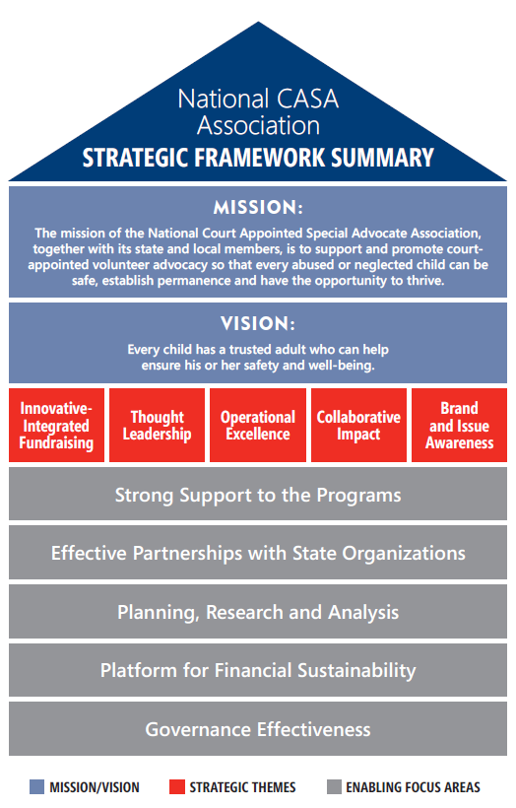

Slide 7
VOCA Background
Ashley Lantz, National CASA

Slide 8
Victims of Crime Act (1984)
Federally-sourced, state-administered grant dollars
Crime Victims Fund (CVF)
Formula grants to states for services to crime victims
Deficit-neutral source of federal funding, derived from criminal fines, fees, and penalties collected in federal courts
Notes:
Assistance with thank you messages forthcoming, did some in person on the Hill
Subcommittee hearings starting in advance of subcommittee markup, mid-April probably.

Slide 9
VOCA Grant Purposes/Eligibility
State grants support direct services, such as counseling, and assistance in participating in the criminal justice system.
VOCA grants are provided to organizations working with victims of domestic violence, sexual assault, child abuse, elder abuse, trafficking, drunk driving, homicide, and other crimes.
Notes:
Assistance with thank you messages forthcoming, did some in person on the Hill
Subcommittee hearings starting in advance of subcommittee markup, mid-April probably.

Slide 10
VOCA Grant Purposes/Eligibility
While federal guidelines exist on the parameters for spending VOCA dollars, states make their own determinations on how and to whom they supply the funding.
The largest percentage of VOCA grants nationwide are awarded to entities that serve domestic violence victims.
Notes:
Assistance with thank you messages forthcoming, did some in person on the Hill
Subcommittee hearings starting in advance of subcommittee markup, mid-April probably.

Slide 11
VOCA Funding for CASA Advocacy
CASA advocacy is an eligible VOCA purpose. Applications, if they are accepted within a state’s guidelines and pending solicitation, should speak to direct services provided to crime victims.
Example: helping child victims of abuse navigate the court system
Notes:
Assistance with thank you messages forthcoming, did some in person on the Hill
Subcommittee hearings starting in advance of subcommittee markup, mid-April probably.

Slide 12
VOCA Funding for CASA Advocacy
In 2013, DOJ released proposed rulemaking that would have clarified the permissible use of “direct service funding in certain circumstances to train direct service providers including Court Appointed Special Advocate (CASA) volunteers and clinical social workers.”
This rule has never been finalized by the White House Office of Management and Budget (OMB).
Notes:
Assistance with thank you messages forthcoming, did some in person on the Hill
Subcommittee hearings starting in advance of subcommittee markup, mid-April probably.

Slide 13
Overall VOCA Funding
Depth and Scope of Crime Victims Fund (CVF) funding
In addition to VOCA, these federal dollars are used for Children’s Justice Act grants, FBI victims specialists, and other related purposes.
In recent history, the total overall federal funding for VOCA, as appropriated by Congress, has averaged $700 million per year (FY 2010-FY 2014).
In 2014, state grants totaled $455 million.
Notes:
Assistance with thank you messages forthcoming, did some in person on the Hill
Subcommittee hearings starting in advance of subcommittee markup, mid-April probably.

Slide 14
Overall VOCA Funding
The VOCA “Surplus”
For several years (including FY 2010-FY 2014), Congress disbursed $700 million per year in for the Crime Victims Fund (CVF) while the Fund was collecting an average of $2 billion per year. The difference was used by Congress as a budgetary offset.
The Crime Victims Fund is projected to have a balance of $11 billion at the end of 2015.
Notes:
Assistance with thank you messages forthcoming, did some in person on the Hill
Subcommittee hearings starting in advance of subcommittee markup, mid-April probably.

Slide 15
Overall VOCA Funding
The VOCA “Surplus”
For FY 2015, Congress provided $2.36 billion in CVF funding, an increase over the FY 2014 level of $745 million. The President proposed $1 billion for CVF in FY 2016.
Senator Pat Toomey (R-PA) has proposed legislation, supported by Senator Kelly Ayotte (R-NH), that would require a steady stream of CVF funding.
Notes:
Assistance with thank you messages forthcoming, did some in person on the Hill
Subcommittee hearings starting in advance of subcommittee markup, mid-April probably.

Slide 16
VOCA Funding Across the CASA/GAL Network
Top VOCA Awards by State
2013 Annual Survey – $15.8 million in Network VOCA Funding
• Texas • New Jersey
• Georgia • Oklahoma
• Ohio • Virginia
Notes:
Assistance with thank you messages forthcoming, did some in person on the Hill
Subcommittee hearings starting in advance of subcommittee markup, mid-April probably.

Slide 17
VOCA Strategies
Cynthia Smith, National CASA

Slide 18
Strategy for New VOCA Applications
State/Local Strategy Decision:
State program application, to distribute funds to local programs?
or
Local programs complete their own applications for VOCA dollars?

Slide 19
Strategy for New VOCA Applications
Begin to Prepare Your Case
Locate your state’s VOCA grant application
http://www.navaa.org/statedirectory.html
Identify VOCA grant awardees in your state
Examine current VOCA information
Office of Victims of Crime, Department of Justice
National Association of VOCA Assistance Administrators

Slide 20
Strategy for New VOCA Applications
Begin Building Relationships
Identify your state VOCA administrator, request a meeting
Review Application Guidelines together
Describe how CASA advocacy fits into the guidelines
Be persistent and follow-up
Keep asking for funding year after year

Slide 21
Issues to Consider
Possible Questions for You
How does the CASA program serve victims of crime?
What direct services does the program provide?
How is the CASA program funded?
Why does your program need this funding?
Why does your program need this funding now?
What would the CASA program do with the funding?
Why has the CASA program not applied before?

Slide 22
Other Potential Approaches For When Challenges Occur
Ask a CASA/GAL champion in the state legislature to make an inquiry to the state administrator
Seek meeting with Governor’s Office/Attorney General’s Office
Pursue a legislative hearing on VOCA, and plan to testify
Explore an amendment to state VOCA guidelines

Slide 23
Network Presenters

Slide 24
Glenn Brooks Texas CASA
*

Slide 25
Jennifer King Georgia CASA
*

Slide 26
Suzanne Hughes CASA of Muskogee
*

Slide 27
Q&A and Open Discussion

Slide 28
Contact Information

Slide 29
National CASA Team
Ashley Lantz and Cynthia Smith
Advocacy@casaforchildren.org
Member Services
MemberServices@casaforchildren.org

